Slide 1
Getting Started Simple Setup

Slide 2
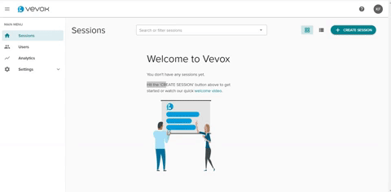
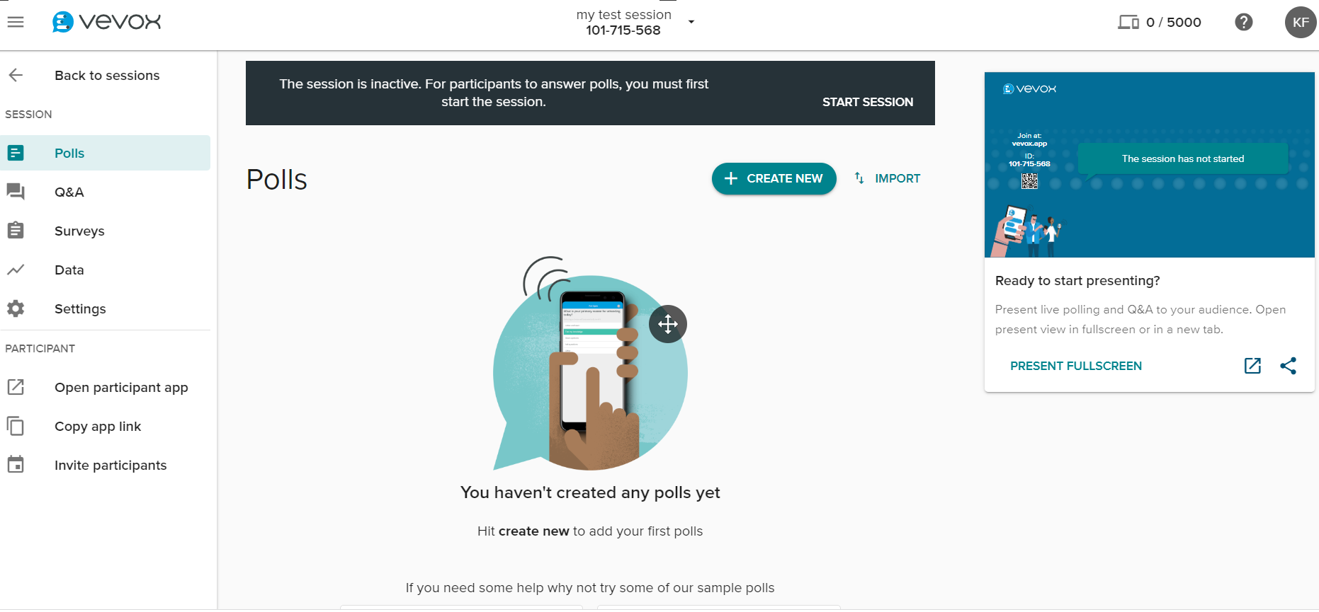
Create my first session
Log In to your dashboard.
Press the 'Create Session' button.
Enter your new session name.
Press 'Create’. You will then
automatically enter the session.
1.
*Depending on your license type, this may inform you that a session currently in progress will be stopped.
2.
Once in the Session, press ‘START SESSION’*

Slide 3
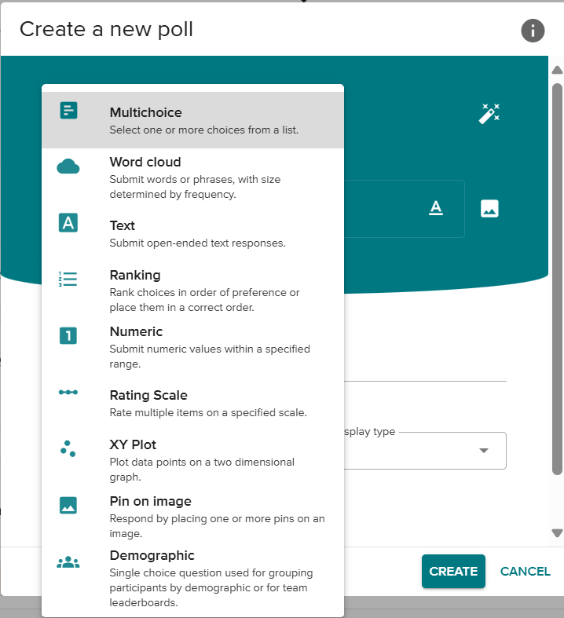
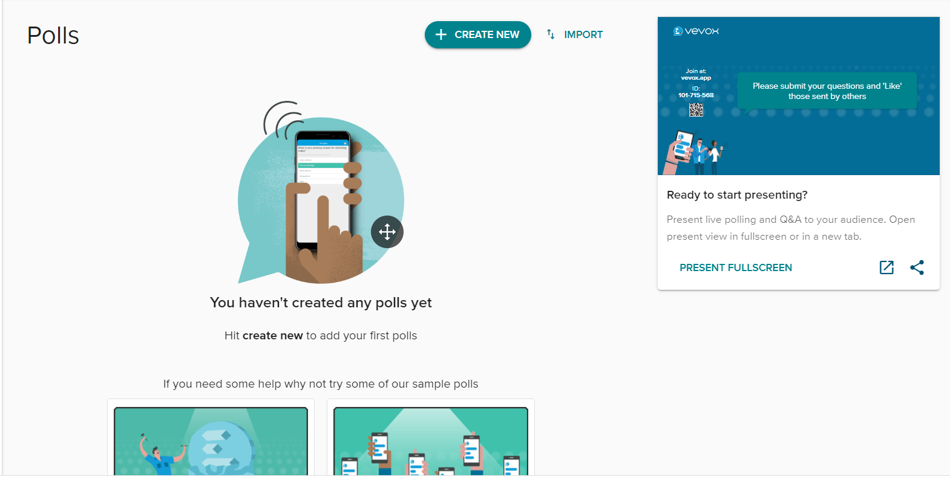
Creating a Poll
1.
2.
Press the
drop-down arrow and select the type of poll you would like to run.
Press ‘CREATE NEW’
Add an image if required
Click the ‘A’ icon next to your correct answer/s if applicable.
5.
6.
3.
Type in your question
Press ‘CREATE’
Please add ‘choices’ if applicable to your question
4.

Slide 4
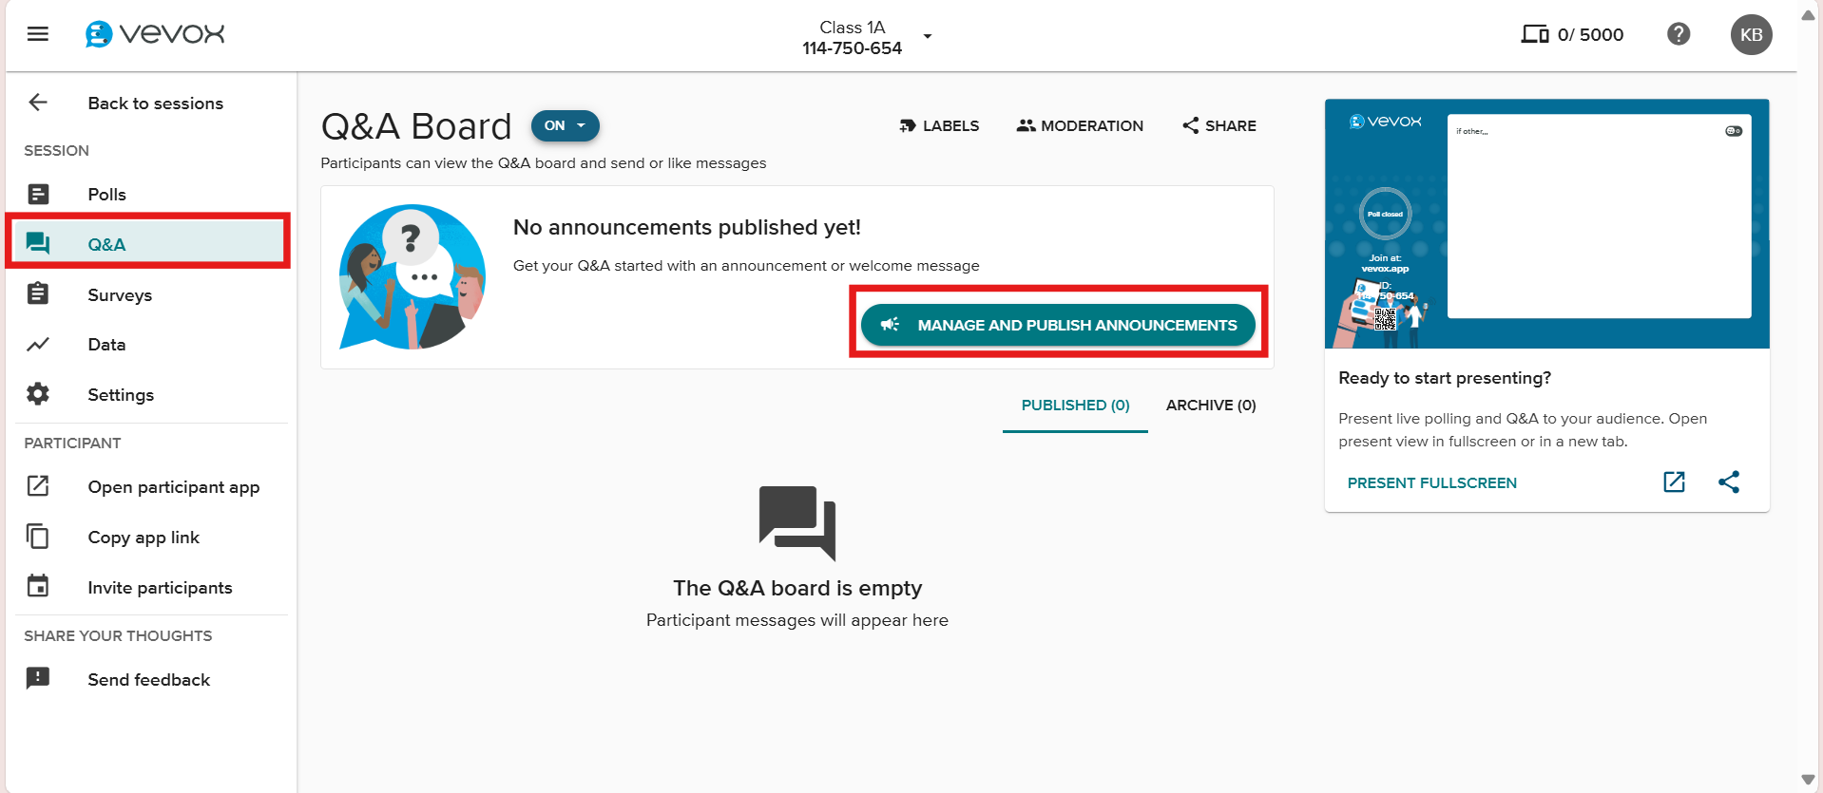
Creating a Q&A board
For using Moderation controls please see:
Using Moderation
3.
Select Q&A from the navigation menu on the lefthand side
1.
Click here to set an announcement (go here for more information)
(who are the questions going to be answer by / type of questions you would like)
2.

Slide 5
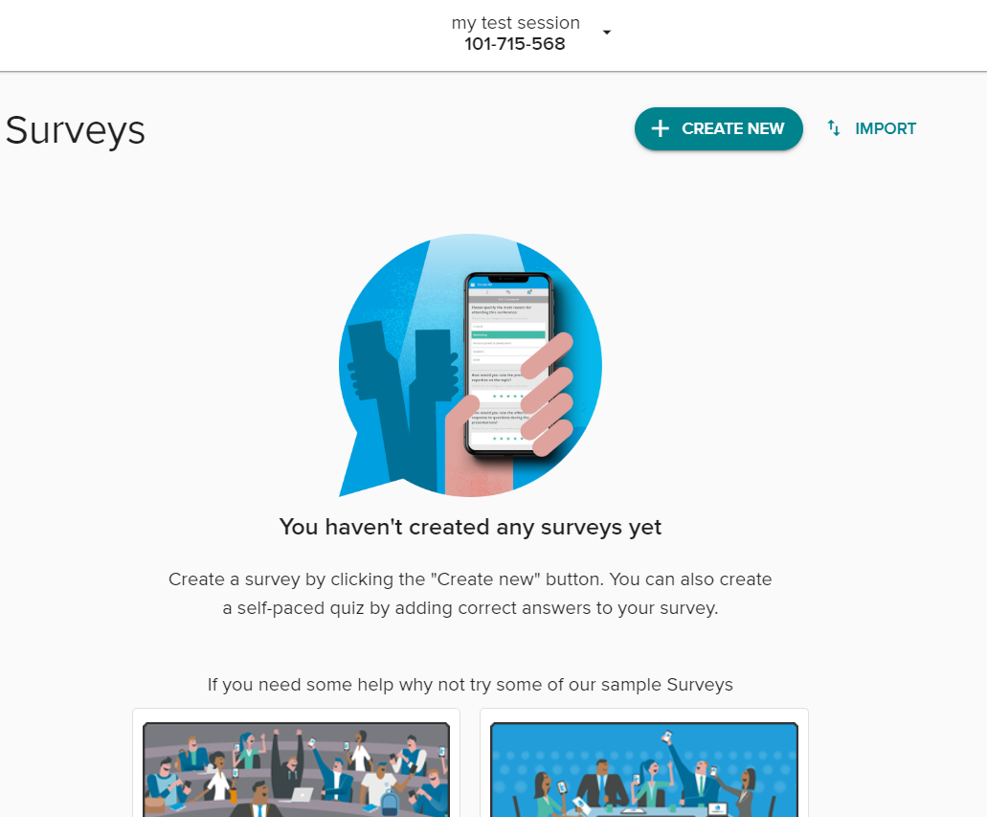
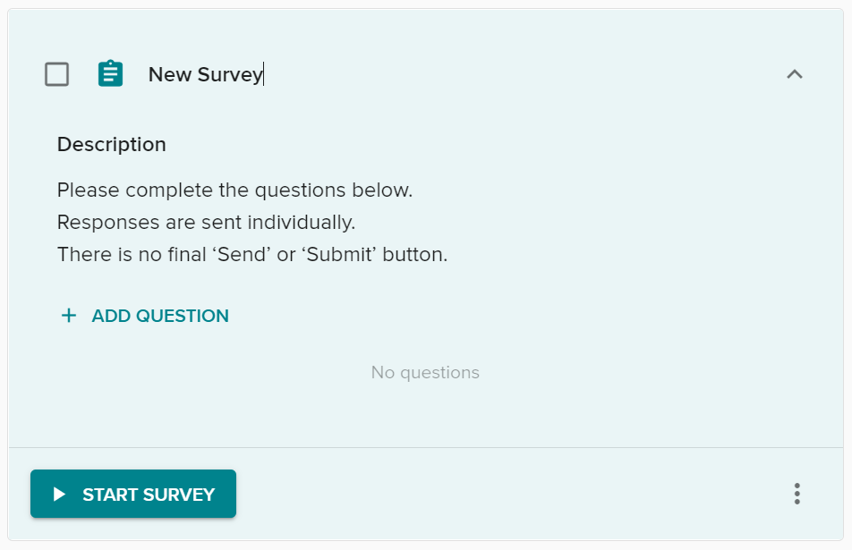
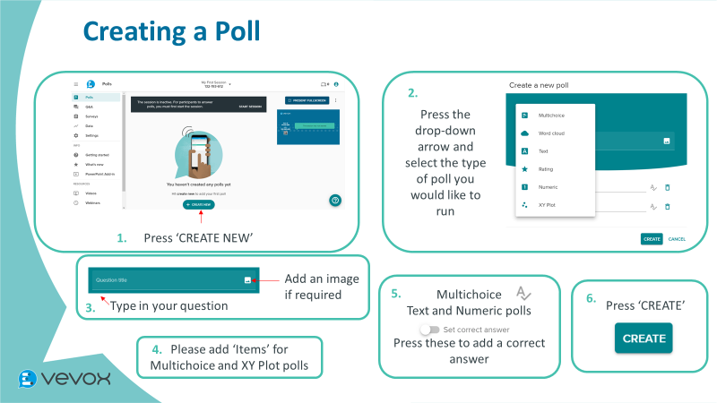
Creating a Survey
1.
2.
Select ‘Surveys’ on the navigation menu and the press ‘CREATE NEW’
Edit your Survey name and press ‘ADD QUESTION’
3.
4.
5.
Add as many questions as required
Don’t forget to
‘START SURVEY’ at the time you need it!
Survey question format is the same as Polls – please see slide Creating a Poll

Slide 6
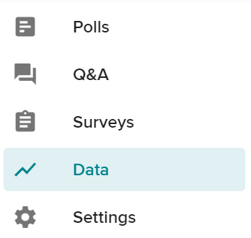
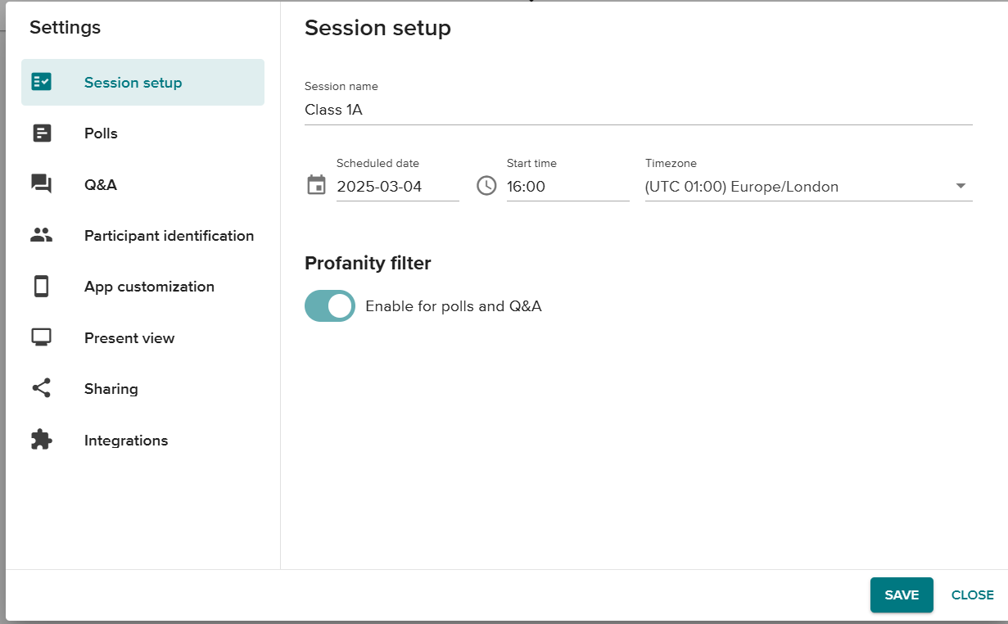
Settings
Remember to ‘SAVE’ any changes you make
Select ‘Settings’ on the feature list – a pop-up should appear
Toggle Moderation control your Q&A board.
Identification settings for participants
Customize the App
Customize Present View
Share the meeting with any colleague who has Vevox access
Toggle on Zoom and Webcast integrations.

Slide 7
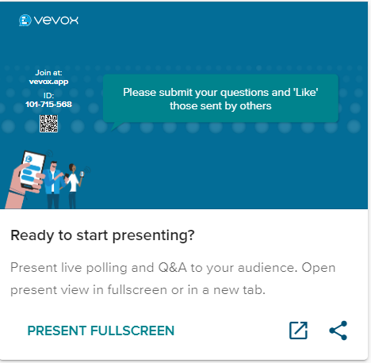
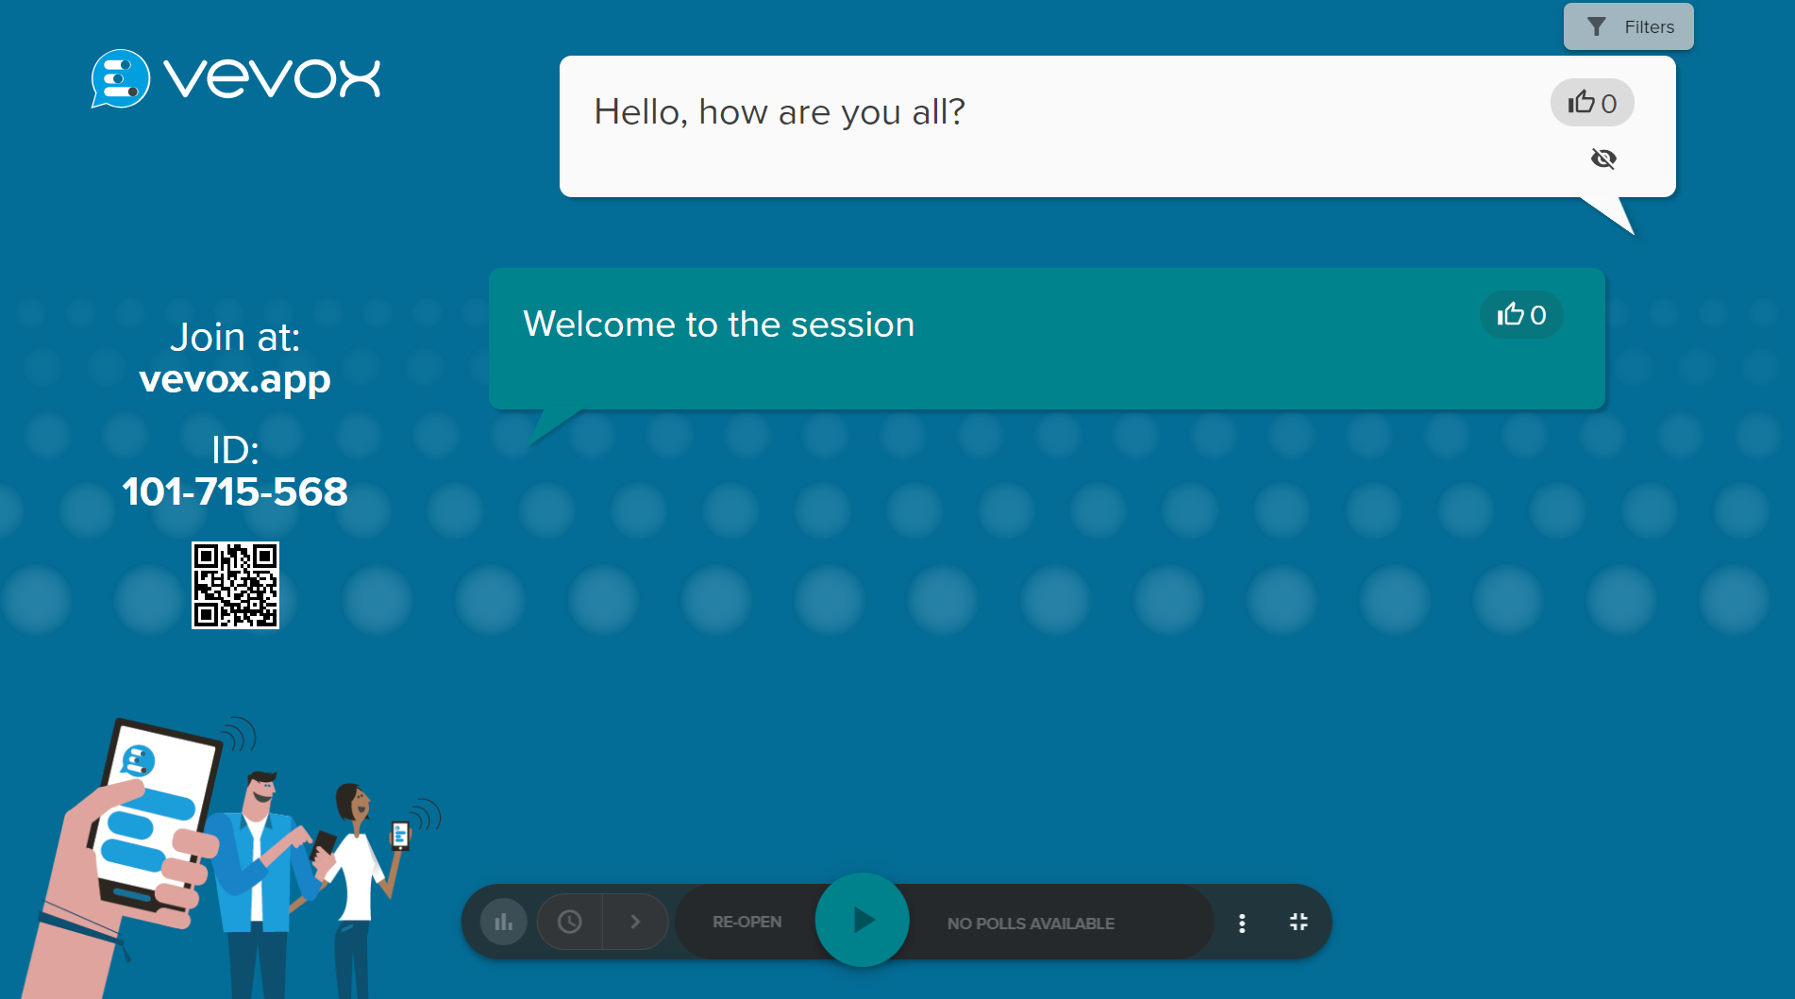
Presenting
If you wish to share Vevox via your screen, please press here
Choose the way you would like to filter replies
Participant Joining Instructions here – Press the QR code to enlarge it at the beginning of your Session
Remove questions from Present view (these will go into an Archive folder in the Q&A tab
Poll controls here – Start, Stop, re-run Polls. Choose to share responses and ‘correct answers’

Slide 8
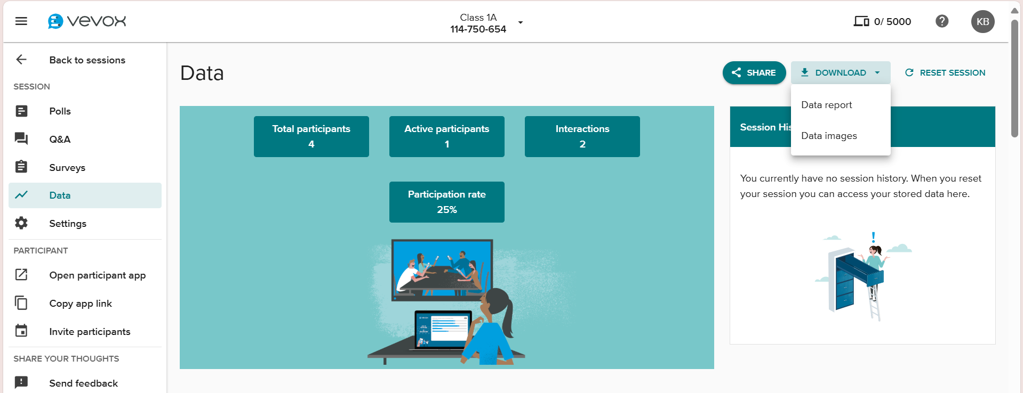
Data
On this page you will see an overview of activity – for more detailed information please expand the ‘download’ menu and select ‘DATA REPORT’
To access your Session data; please press the Data tab in the navigation menu
For more advanced setup and further resource please see:
https://help.vevox.com/hc/en-us
For ‘in dashboard’ live help please press:
Which can be found on the top right of your dashboard screen

